Slide 1
Week 2
Open Source Intelligence
Password Cracking

Slide 2
Tentative Schedule
Week | Date | Topic
1 | Thursday, February 1, 2018 | Introduction
2 | Thursday, February 8, 2018 | Open Source Intelligence / Password Cracking
3 | Thursday, February 15, 2018 | Password Cracking / Network Traffic Analysis
4 | Thursday, February 22, 2018 | Network Traffic Analysis
5 | Thursday, March 1, 2018 | Log Analysis
6 | Thursday, March 8, 2018 | Cryptography
7 | Thursday, March 15, 2018 | Scanning
8 | Thursday, March 22, 2018 | Web Application Exploitation
9 | Thursday, March 29, 2018 | Wireless Access Exploitation
10 | Thursday, April 5, 2018 | GYM IS OPEN BEGIN ON TOPICS THERE

Slide 3
Coaches Call Update
Last Call: 2/7/18
Topic: Incorporate NCL into your curriculum for maximum efficiency!

Slide 4
Objective
Focus on getting the most flags possible
Given your level of exposure you will learn to use a lot of GUI based applications rather than command line
Command line will generally offer more functionality but has a higher learning curve
The competition does not judge how you find the solution, only that you did

Slide 5
Open Source Intelligence
Bronze

Slide 6
Real World Relevance
Reconnaissance on a target before an audit
Understanding public information for your own company

Slide 7
Meta Data
Tests ability to extract data from a picture
Built in windows
Online tools
http://exif.regex.info/exif.cgi

Slide 8
Lookup
Ability to use ICAN, WHOIS, DNS Lookup services to find data about domains
Linux Command
Dig “domain”
MXTOOLBOX
https://mxtoolbox.com/DNSLookup.aspx

Slide 9
Threat Intel
CVE - Common Vulnerabilities and Exposures (CVE)
https://cve.mitre.org/
Rapid7
https://www.rapid7.com/db/search

Slide 10
Samy is my…
Samy Kamkar
https://samy.pl/

Slide 11
Open Source Intelligence
Silver

Slide 12
HTTP
Ability to understand Http headers
ncl.cyberskyline.com
Developer tools > Network

Slide 13
Email
Understanding the raw email message

Slide 14
Password Cracking

Slide 15
Real World Relevance
Checking the strength of passwords
Recovering locked out computers
Privilege escalation of compromised system

Slide 16
What is a Hash?
A hash function is any function that can be used to map data of arbitrary size to data of fixed size
Example Hashes
https://hashcat.net/wiki/doku.php?id=example_hashes

Slide 17
PWDUMP Format

Slide 18
Hashes
$1 = MD5 hashing algorithm.
$2 =Blowfish Algorithm is in use.
$2a=eksblowfish Algorithm
$5 =SHA-256 Algorithm
$6 =SHA-512 Algorithm
Notes:
https://null-byte.wonderhowto.com/how-to/hack-like-pro-crack-user-passwords-linux-system-0147164/

Slide 19
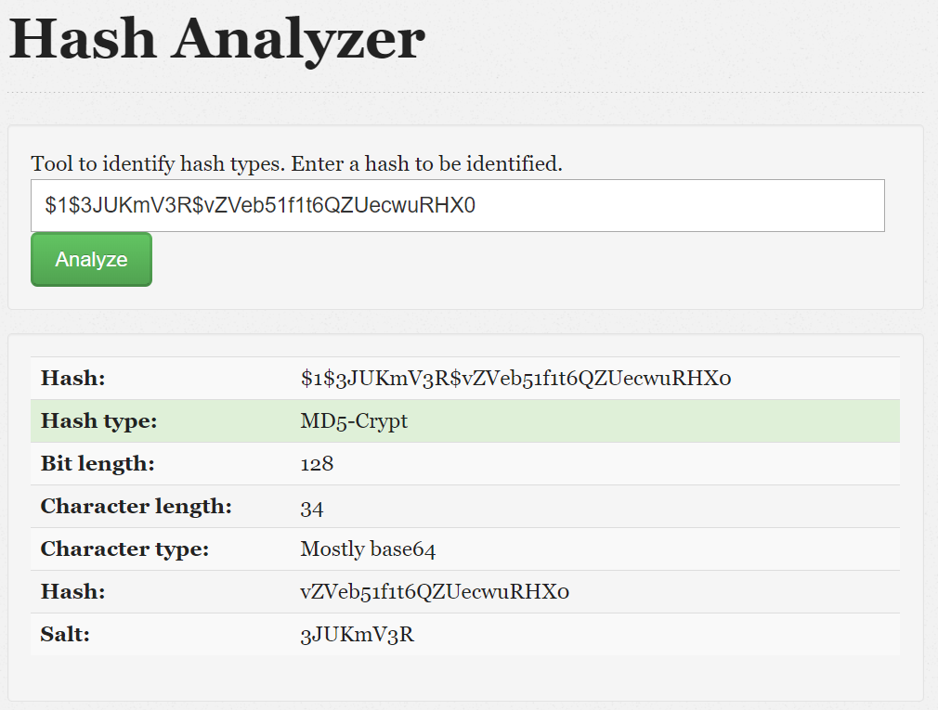
HASH Analyzer
Notes:
https://www.tunnelsup.com/hash-analyzer/

Slide 20
Hash Type
Salt
Value

Slide 21
Salt?
Random data that is used as an additional input to a one-way function that "hashes" data, a password or passphrase. ... The primary function of salts is to defend against dictionary attacks or against its hashed equivalent, a pre-computed rainbow table attack.

Slide 22
Crack Station
https://crackstation.net/

Slide 23
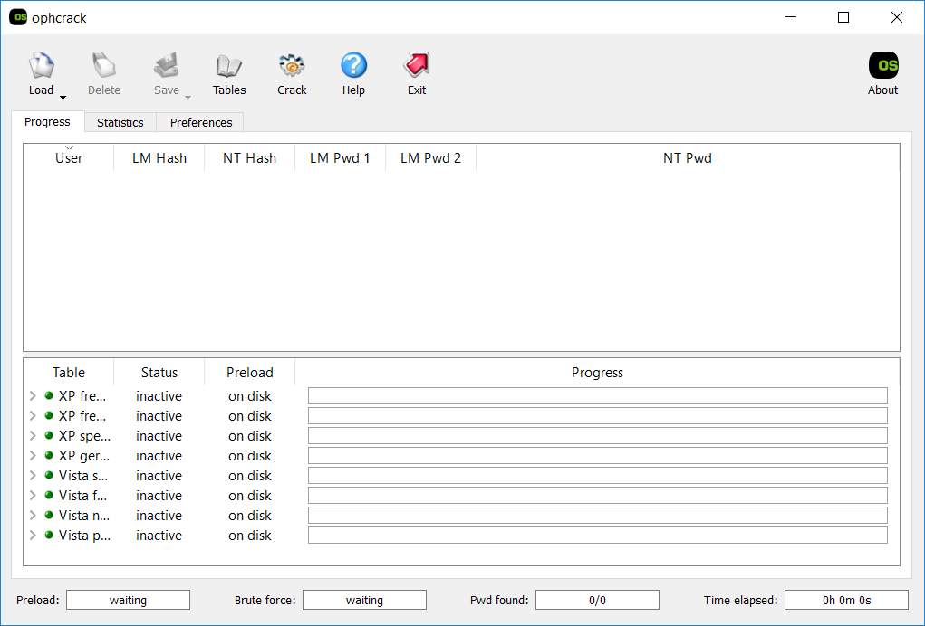
OPH Crack

Slide 24
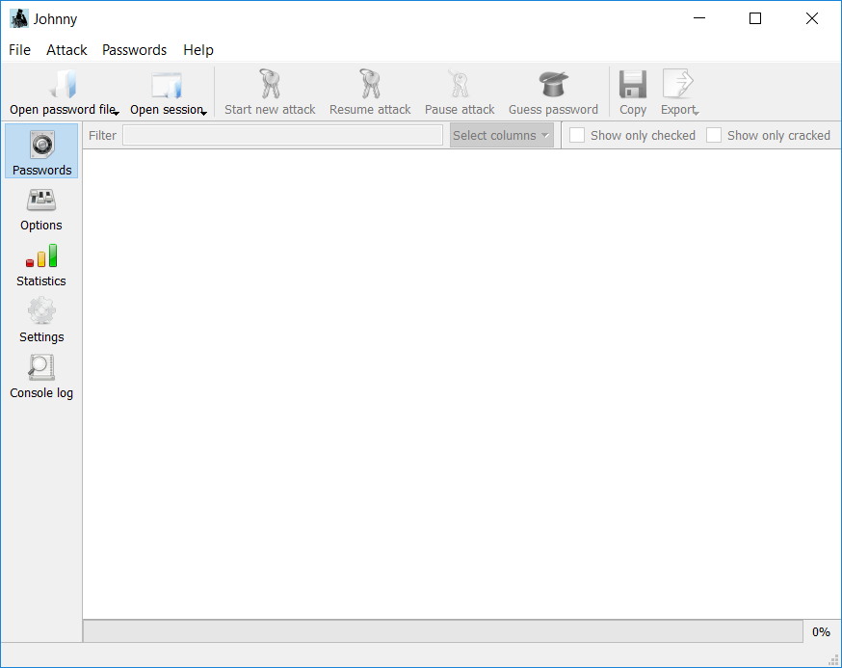
Here's Johnny!

Slide 25
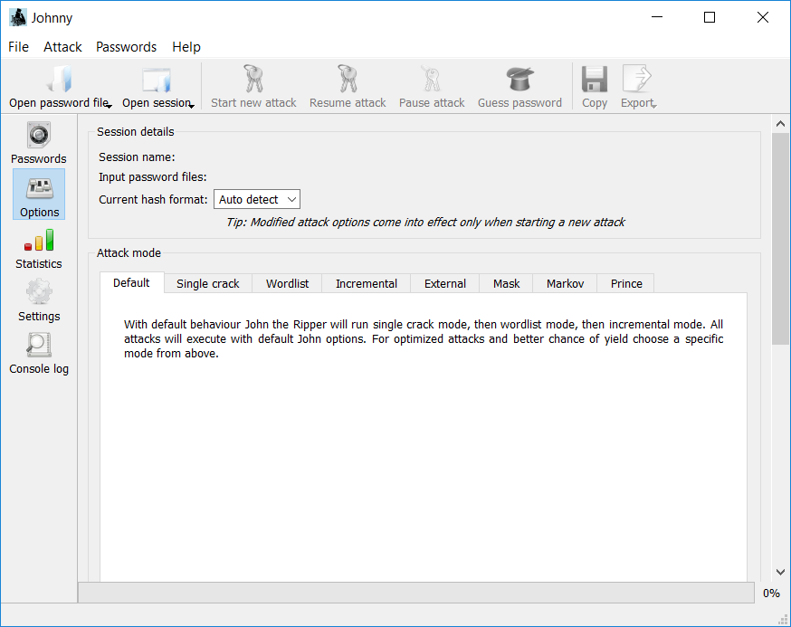
Attack Modes

Slide 26
Examples
We have managed to extract passwords from the system. We have discovered that they have to do with Pokemon…

